Slide 1

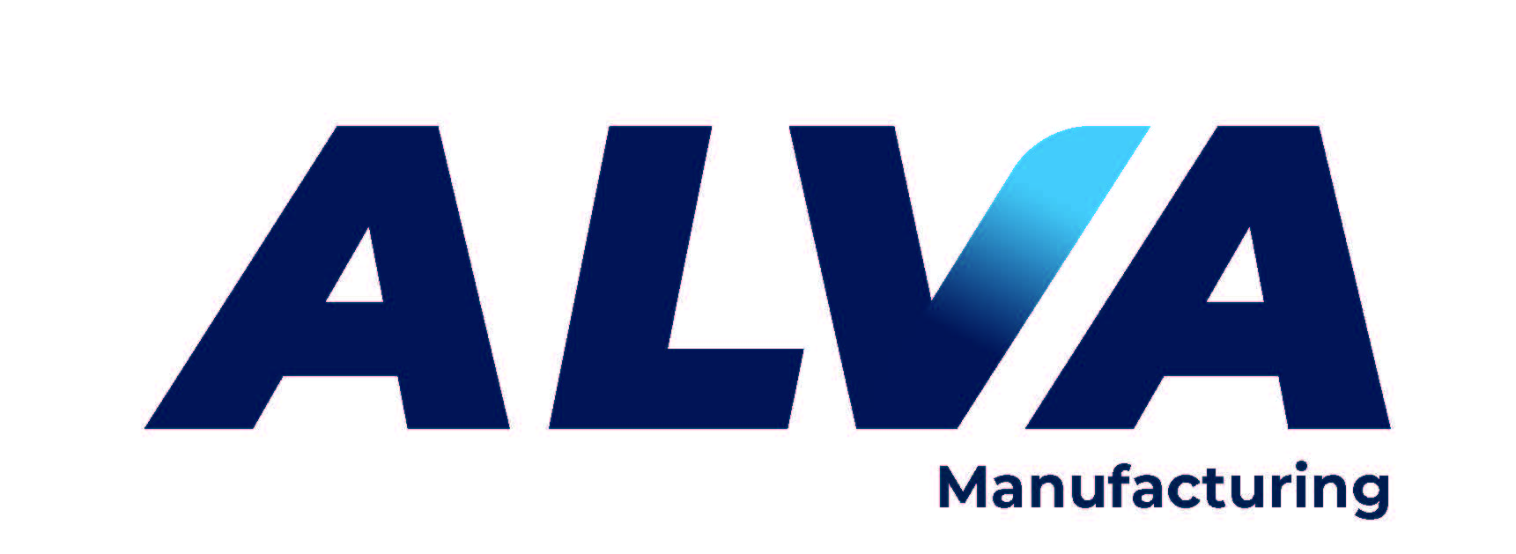








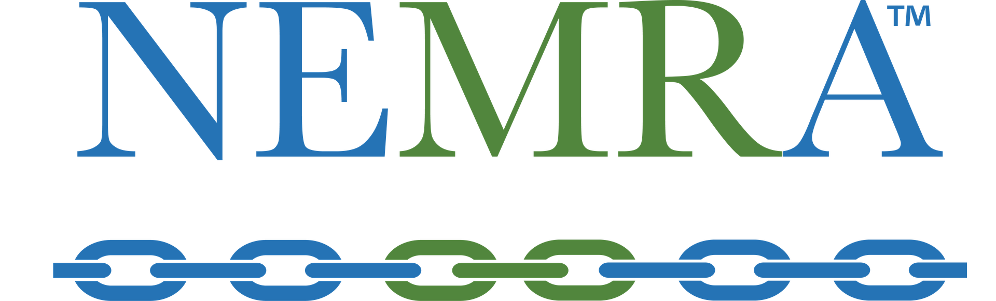
World Class Electrical Enclosures. Commercial & Industrial NEMA, Non-Metallic, Stainless, Modified, & Specials https://www.hubbell.com/wiegmann/en
High-quality PVC conduit solutions
UL-certified conduits: Sch 40, Sch 80,
Fittings, Direct Burial, Encased Burial, Solvent Cement.
About | E-Z Weld Conduit
Steel, Nonmetallic, Weatherproof & While-in-use Boxes,
Covers, Fittings, Innovative products & more.
https://www.hubbell.com/raco/en
https://www.hubbell.com/taymac/en
https://www.hubbell.com/bell/en
American Made Leading producer of Aluminum Rigid & EMT conduit.
1/3rd the weight of steel conduit without sacrificing strength.
Our conduit is light, durable and corrosion resistant.
https://www.americanconduit.com
Total Power Quality Solutions, surge suppression, UPS, Active tracking filters, Power Supplies.
Free Standing and Din Rail Mounted
https://www.emerson.com/en-us/automation/solahd
Industrial, Commercial, Institutional & Residential
electrical products
https://www.hubbell.com/bryant/en
Wire and Splicing Connectors Hand Tools: strippers, cutters & crimpers
Smart Printers – thermal transfer printer https://www.wago.com/us/
American Made
Double-Insulated 1000 Volt Tools & PPE.
Glove testing & certification
https://www.cementexusa.com/
Domestically manufactured products, including strut (metal & fiberglass) fittings, cushioned and insulated clamps and roof-top support systems.
Available in various finishes to suit all your needs.
Wesanco-ZSI.com
Reliable and easy to install heating products.
Roof & Gutter, Snow Melt, Floor Warming
https://www.easyheat.com
Sub-Metering & Energy Monitoring Systems
(Electric, Gas, Water & BTU)
https://buildings.honeywell.com/us/en/brands/our-brands/bms/energy-meters
Corporate HQ Wallingford CT
www.NortheastMarketing.com
Inside sales/support : (203) 265-0012
Lee Ann – LALionetti@northeastmarketing.com

