Slide 1

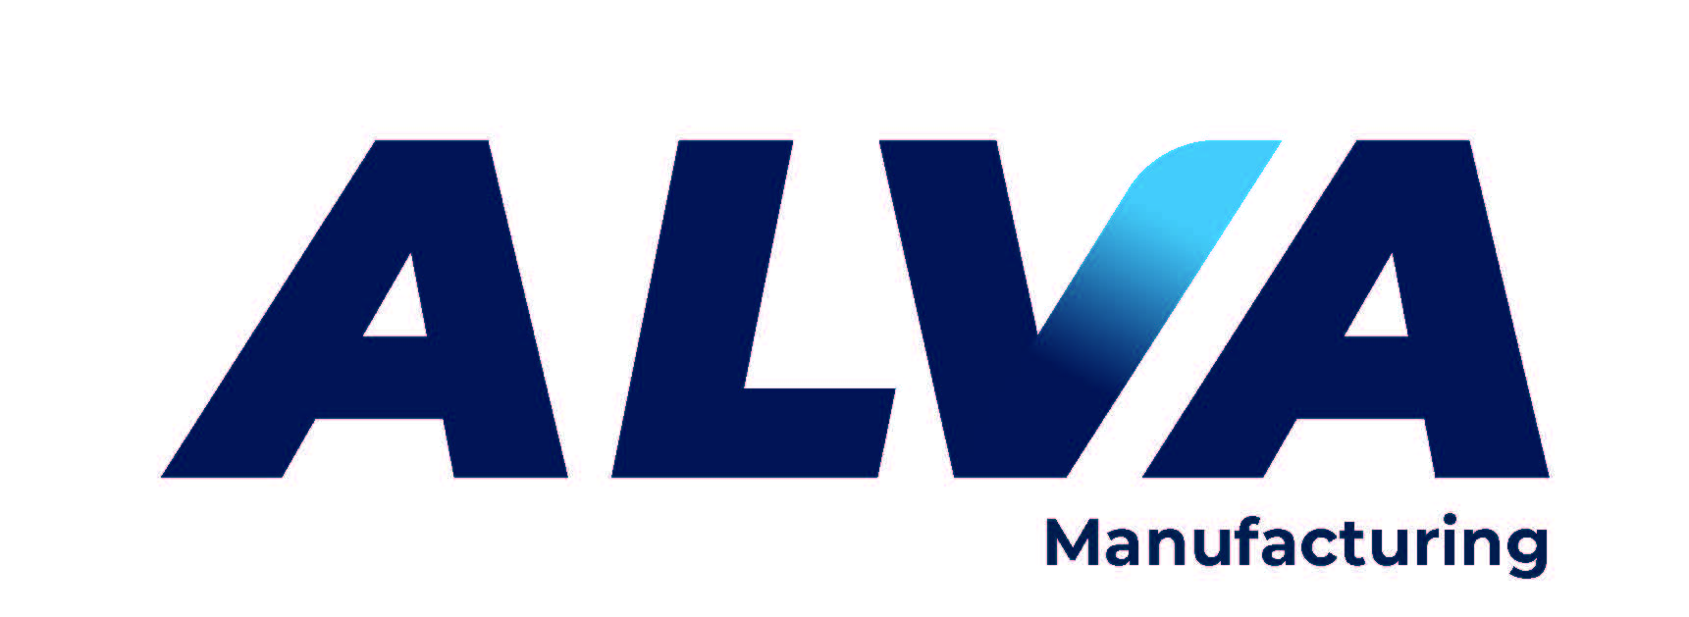










World Class Electrical Enclosures.
Commercial & Industrial
NEMA, Non-Metallic, Stainless, Modified, & Specials
WIEGMANN
Christopher Casey
Vice President & Outside Sales
ccasey@northeastmarketing.com
Cell: 207-844-0258
High-quality PVC conduit solutions
UL-certified conduits: Sch 40, Sch 80,
Fittings, Direct Burial, Encased Burial, Solvent Cement.
ALVA
American Made
Leading producer of Aluminum Rigid & EMT conduit.
1/3rd the weight of steel conduit without sacrificing strength.
Our conduit is light, durable and corrosion resistant.
American Conduit
Optergy Proton - Scale from small to all.
Web-based building interface device that combines building automation, energy management & facility management.
Optergy Proton
Industrial, Commercial, Institutional & Residential
electrical products
Bryant
Steel, Nonmetallic, Weatherproof & While-in-use Boxes,
Covers, Fittings, Innovative products & more.
RACO - TAYMAC - BELL
American Made
Double-Insulated 1000 Volt Tools & PPE.
Glove testing & certification
Cementex
Total Power Quality Solutions, surge suppression, UPS, Active tracking filters, Power Supplies.
Free Standing and Din Rail Mounted
SOLA-HD
KWH load monitoring. Designed for flexibility and integration, these High-Density sub-meters are perfect for a variety of applications,
Residential complex, commercial buildings and retail.
DENT Instruments
Wire and Splicing Connectors
Hand Tools: strippers, cutters & crimpers
Smart Printers – thermal transfer printer
WAGO
Reliable and easy to install heating products.
Roof & Gutter, Snow Melt, Floor Warming
Easy Heat
Sub-Metering & Energy Monitoring Systems
(Electric, Gas, Water & BTU)
Honeywell E-MON
Corporate HQ Wallingford CT
www.NortheastMarketing.com
Inside sales/support : (203) 265-0012
Lee Ann – LALionetti@northeastmarketing.com

